Slide 1
Sequential Search in Python
Siddhant Narayan bharti

Slide 2
What is Sequential Search?
Sequential Search, also known as Linear Search, is a simple search algorithm. It checks each element of the list one by one. The process continues until the target element is found or the list ends.

Slide 3
How Sequential Search Works
1. Start from the first element. 2. Compare the target element with the current element. 3. If a match is found, return the index. 4. If no match, move to the next element. 5. Repeat until the element is found or the list ends.

Slide 4
Pseudocode of Sequential Search
For each element in the list: if element == target: return index return -1 # not found

Slide 5
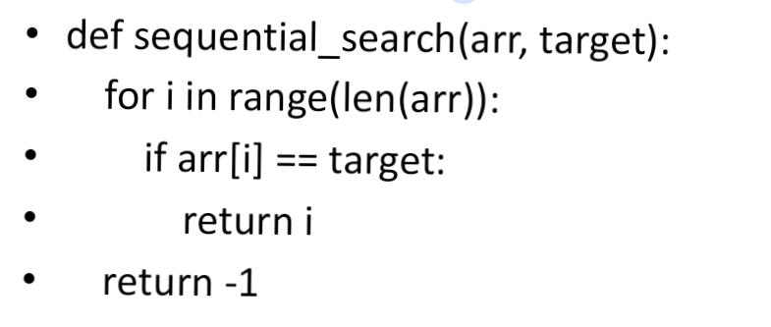
Python Code Example

Slide 6
antages and Disadvantages
Advantages: -Simple and easy to implement - No need for sorted data Disadvantages: - Inefficient for large datasets - Time complexity: O(n)

Slide 7
When to Use Sequential Search
When the dataset is small - When data is unsorted - When simplicity is more important than efficiency

Slide 8
Conclusion
Sequential Search is a basic but useful algorithm. It is best suited for small or unsorted datasets. Understanding it builds a foundation for learning more advanced search techniques

Slide 9
Thank you 😊

